Slide 1
Versioning Strategy for REST
Start debate about versioning for REST
Haroldo Macêdo
Notes:
The idea here is to create as strategy an policy for REST versioning.

Slide 2
KISS
Keep
It
Simple &
Stupid
“That's been one of my mantras - focus and simplicity. Simple can be harder than complex: You have to work hard to get your thinking clean to make it simple. But it's worth it in the end because once you get there, you can move mountains.”
Steve Jobs
Notes:
Main principle that should drive ones choices and decisions.
Simplicity leads to faster and cheaper execution of tasks, with less errors and rework.

Slide 3
Today’s Policy is for SOAP
Create a versioning strategy and policy for REST
SOAP versioning document only
Need to define tools for
Registry
Source Control
Deployment
Notes:
Versioning Policy
There is no policy or strategy for REST
Registry – CentraSite
Source Control – RTC or
Deployment – Manual / Automatic (CD)

Slide 4
Rapid analysis on REST
What is important for versioning

Slide 5
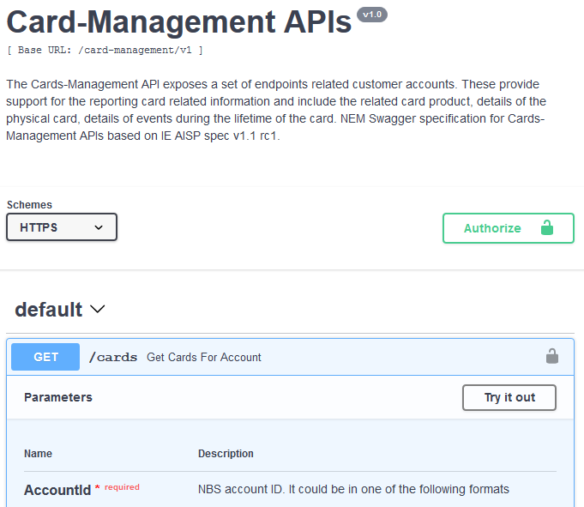
REST Properties for Versioning
New Major Version
basePath (any change)
May Version
paths
Other properties
Paths methods (POST, GET etc.)
parameters (paths property)
responses (paths property)
Notes:
Mandatory for new major version
New basePath implies a new version or a new service by definition.
Depending on the changes on “path” and other properties, the major version may or may not change. See next slides.

Slide 6
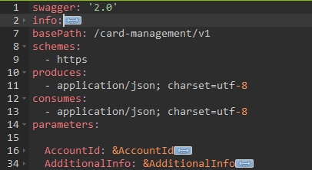
REST Properties for Versioning – New Major Version
Not expected to change
swagger (2.0)
schemes (https)
parameters (for the header)
security (JWT [])
securityDefinitions (JWT)
host (Not Used)
consumes (application/json; charset=utf-8)
produces (application/json; charset=utf-8)
Notes:
Mandatory for new major version
If any of these properties are changed, the major version must be changed.
These properties should not change, tough.

Slide 7
Incompatible Changes
Removal of a method (POST, GET etc.)
Inclusion, removal or change of a required parameter
Removal or rename of a any property of a request object
Inclusion of a required property of a request object
Inclusion of a new response
Incompatible changes on an object (optional or required)
Notes:
Mandatory for new major version
Any of the changes here forces a major version because of the backward incompatibility.

Slide 8
Incompatible Changes on an Object
Change on the following properties of object
<Property Name>
type
format
pattern
enum
allowEmptyValue
collectionFormat
multipleOf
allOf
uniqueItems
maximum
minimum
exclusiveMaximum
exclusiveMinimum
maxLength
minLength
maxItems
minItems
Notes:
May be mandatory for new major version
Any of the changes on these properties probably forces a major version due to backward incompatibility.

Slide 9
Proposals
New major versions
additionalProperties property

Slide 10
Proposal 1 – New Major Version Options
New Interface
Any changes on the interface
Even if it is backward compatible
Backward incompatible
When the new interface is not backward compatible
Changes that don’t break the call
New method
New optional property on request
New filter attribute
New enum value
Notes:
When a new major version should be created.

Slide 11
Proposal 1 – Comparison Table
Option | KISS | Major Versions | Complexity on Using | Security Concerns | Governing
1) New Interface | More | More | Less | Less | Less
2) Backward Incompatible | Less | Less | More | More | More
Notes:
KISS – If it is simpler to decide, implement or use.
Major Version – Amount of major versions will be created.
Complexity on Using – From the client point of view, no hidden info.
Security Concerns – From security point of view, no minor version rises security concerns
Governing – More control over the services.

Slide 12
Proposal 2 – additionalProperties Property
Allow the inclusion of properties not described in the Swagger file
Default: true
Allow backward compatibility
Inclusion of properties doesn’t break the client
additionalProperties other values
type: object
properties:
...
additionalProperties: true
Notes:
Property that can be used to simplify versioning, allowing new properties to be included in objects.

Slide 13
Proposal 2 – New Major Version Options
additionalProperties: true
New properties can be included in objects
additionalProperties: false
No new properties can be included in objects
additionalProperties: <other>
Restrict what additional properties can be created
type: object
properties:
...
additionalProperties:
type: string
Notes:
Additional properties may be true, false or define a constraint or type.

Slide 14
Comparison Table
Option | KISS | Major Versions | Complexity on Using | Security Concerns | Governing
A) additionalProperties: true | Most | Least | Least | Most | Less
B) additionalProperties: false | Less | More | More | Less | Most
C) additionalProperties: <other> | More | Less | Less | More | More
Notes:
KISS – If it is simpler to decide, implement or use.
Major Version – Amount of major versions will be created.
Complexity on Using – From the client point of view, no hidden info.
Security Concerns – From security point of view, no minor version rises security concerns
Governing – More control over the services.

Slide 15
Versioning Strategy for REST
Haroldo Macêdo

